Slide 1
Drowning: A Quick and Silent Killer
In the time it takes to …
…cross the room for a towel (10 seconds), a child in the bathtub can become submerged.
…answer the phone (2 minutes), that child can lose consciousness.
…sign for a package at your front door (4 to 6 minutes), a child submerged in the bathtub or pool can sustain permanent brain damage.
www.safekids.org

Slide 2


The ABC’s of Drowning Prevention
Caregiver Workshop

Slide 3
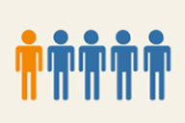
National Drowning Injuries & Death Statistics
Among preventable injuries, drowning is the leading cause of death for children 1 – 4 years old.
Statistics only show deaths, but for every…
  1 Drowning Death there are 4 Hospitalizations
  1 Hospitalization there are 4 ED Visits
  The annual cost of care per year in a chronic care facility for an impaired survivor of a non-fatal drowning is $180,000
www.safekids.org
Notes:
Leading cause is suffocation for kids under 1 and motor vehicle traffic for kids 5-14
As of December 2010, almost 700 people who are given services by the CA Department of Developmental Services have drowning as a risk factor.
When thinking of drowning, most people think either you die or are alright. In reality, many non-fatal drowning survivors end up brain damaged and need full time care for the rest of their lives.

Slide 4
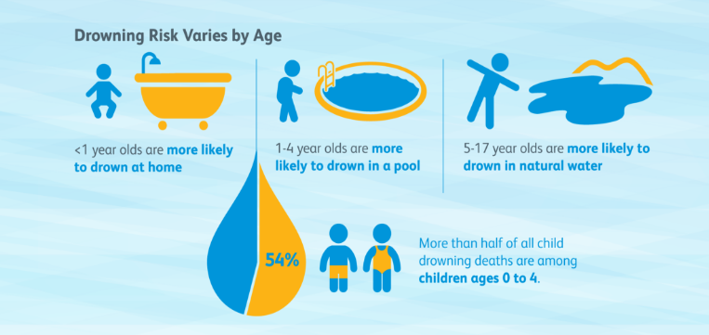
National Drowning Injuries & Death Statistics
Safe Kids Worldwide

Slide 5
National Drowning Injuries & Death Statistics
More than 75% of victims had been missing for 5 minutes or less
  A child loses consciousness in 30 seconds or less
  The brain suffers irreparable damage in 4-6 minutes
  The child can die within 10 minutes.
Notes:
When you have toddlers or preschoolers in your house, the time to check on them is when you hear nothing.

Slide 6
Sacramento County
49 drowning deaths from 2012-2021 (10 years, all ages)
69% (34 of 49) of child drowning deaths occur in children 6 years of age and younger (2012-2021)
Leading cause of injury-related death for children ages 1 year to 4 years of age.
100% preventable
Sacramento County CDRT, 2012-2021
Notes:
5 Drowning Deaths in 2015
2 were under 6 years of age
Yes, the leading cause of injury related death for children aged 1 year through 4 years.

Slide 7
Safe Beginnings Collaborative
Research Results
Why do children drown?
Three factors contribute to a child’s risk of drowning:
The age of the child
Easy access to water
Inadequate adult supervision
Children’s Hospital of Orange County

Slide 8
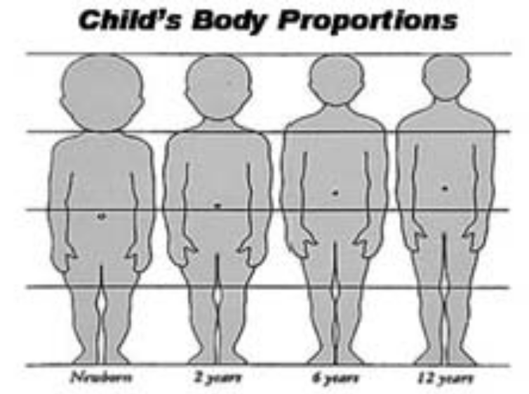
Risk Factor #1 – Age
Developmentally –
  No fear
  Greater curiosity
  Master new skills quickly
Physiologically –
  Head weighs more than the rest of the body
  Bones, tendons & muscles not fully developed
  Can drown in as little as 2 inches of water
  Children’s Hospital of Orange County
Notes:
Children do not understand or perceive the hazards that water presents to them. They have no real sense of danger and require a high level of supervision.
They are naturally inquisitive and are attracted to water. As children grow they become more mobile and like to explore. This may mean they begin climbing over barriers that are designed to keep them away from water.
Young children are also at risk because of their physical build. They are ‘top heavy’ and prone to falling into water due to a lack of balance.

Slide 9
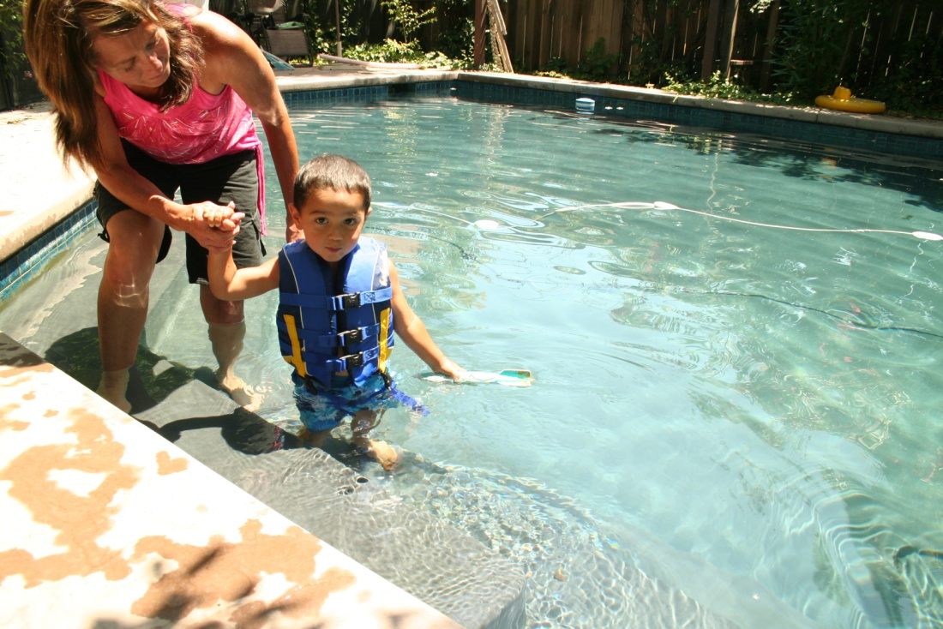
Risk Factor #2- Easy Access to Water
Children under the age of 6 most often drown in a residential pool or spa.
Lack of an effective barrier between a child and a body of water.
Bodies of water include:
  Pool/ Spa
  Bathtub
  Toilet
  Bucket
  River/Lake
  Children’s Hospital of Orange County

Slide 10
Risk Factor #3- Inadequate Adult Supervision
Children have more time and opportunity to access water when:
Parents fail to communicate about supervision
Older children supervising other children
Parents are intoxicated during social gatherings
Parents are sleeping or distracted
Children’s Hospital of Orange County
Notes:
A common theme we hear is Mom thought Dad was watching the child and Dad thought Mom was watching the child.

Slide 11

Sacramento County
ABC’s of Drowning Prevention
A is for Adult Supervision
B is for Barriers
C is for CPR & Classes

Slide 12
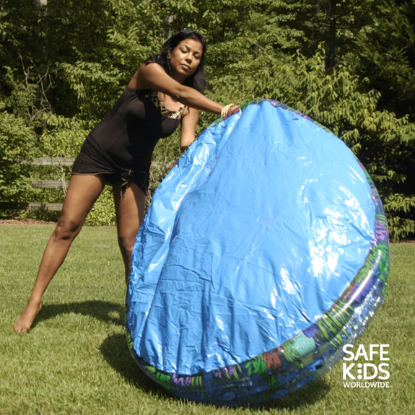
A is for Adult Supervision
Supervision during non-water activities
Children drown without a sound
69% of children who drowned in swimming pools were not expected to be in or around water so know where your children are at all times.
Empty all tubs, buckets, containers, kiddie pools immediately after use and turn them upside down
Notes:
Tragically, many drowning deaths occur in the few seconds that parents are distracted. Active supervision means your child is being continually watched by you or an appropriate adult. If the child is under five years of age or a non-swimmer you should practice touch supervision which is being within arms’ reach of them at all times.
Supervision should be constant, not the occasional glance whilst you read a book or just relax. Regardless of what you are doing, ALWAYS keep your eyes on the children whenever they are in, on or around water. Never under any circumstances leave them alone!
Demonstrate water wings
poke one with needle a few times
blow both up before presentation, squeeze a little air out of the one with holes
show parents that you cannot see the holes, but it can deflate over time
Demonstrate Water Watcher Hat
a Water Watcher can change every 15 minutes, but needs to be easily identifiable by the children in the pool

Slide 13
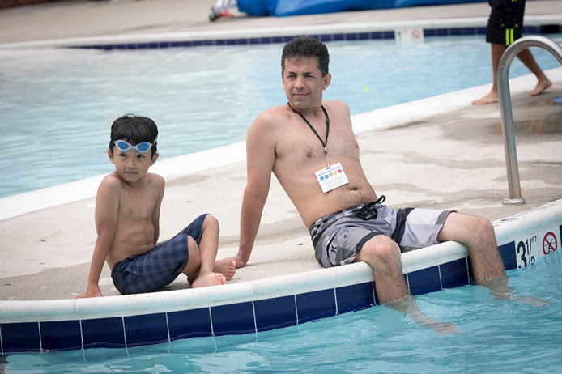
A is for Adult Supervision
Supervision during water activities
Children should be watched by a responsible adult 100% of the time they are in or near the water.
Keep children under age 5 within arm’s reach in the water
Water wings, floaties and even life jackets should never take the place of adult supervision.

Slide 14
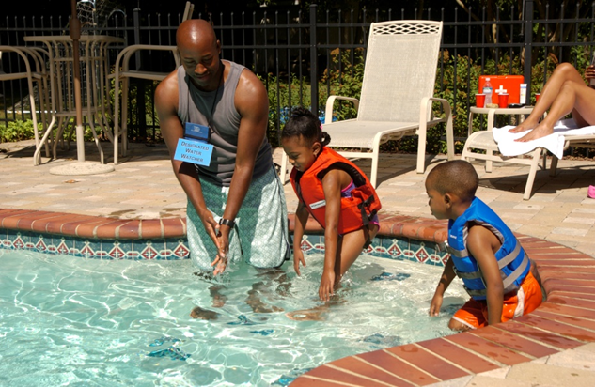
A is for Adult Supervision
Assign a “Water Watcher”
  Adult
  Knows how to swim
  No distractions – phone, reading, alcohol
  15 minute shifts
  Way to identify Water Watcher
  Water Watcher on duty tells kids it is ok to get in the pool
  Part of party planning!

Slide 15
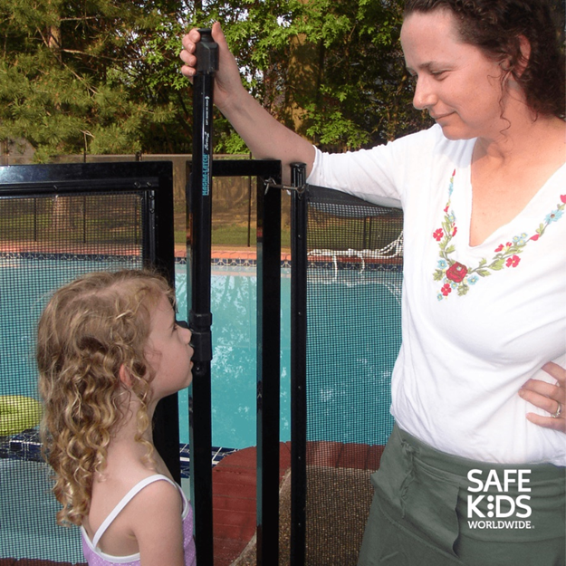
B is for Barriers
The only proven effective barrier is a 5 feet tall non-climbable fence with self-closing, self-latching gates that completely encloses the pool.
Secondary barriers include alarms and pool & spa covers
Install, inspect and always use barriers
Notes:
Self-Closing, Self Latching means it is spring loaded
therefore it does not require a person to push or latch it closed
Other layers, such as alarms provide warnings. They should be supplemental in that they can run out of batteries or you can get ‘used’ to the sound.
They warn an adult that someone got out of the back door, but don’t stop a child from entering the water.
There are approved safety covers that prevent access to water, but it takes a person to put it on. What if you forget?
Don’t try to be an expert on barriers.

Slide 16
B is for Barriers
Remove toys from in or around the pool area. Toys can attract young children to the pool.
Keep chairs, tables and other climbable things away from fence.
Visit National Drowning Prevention Alliance website to learn more about layers of protection.

Slide 17
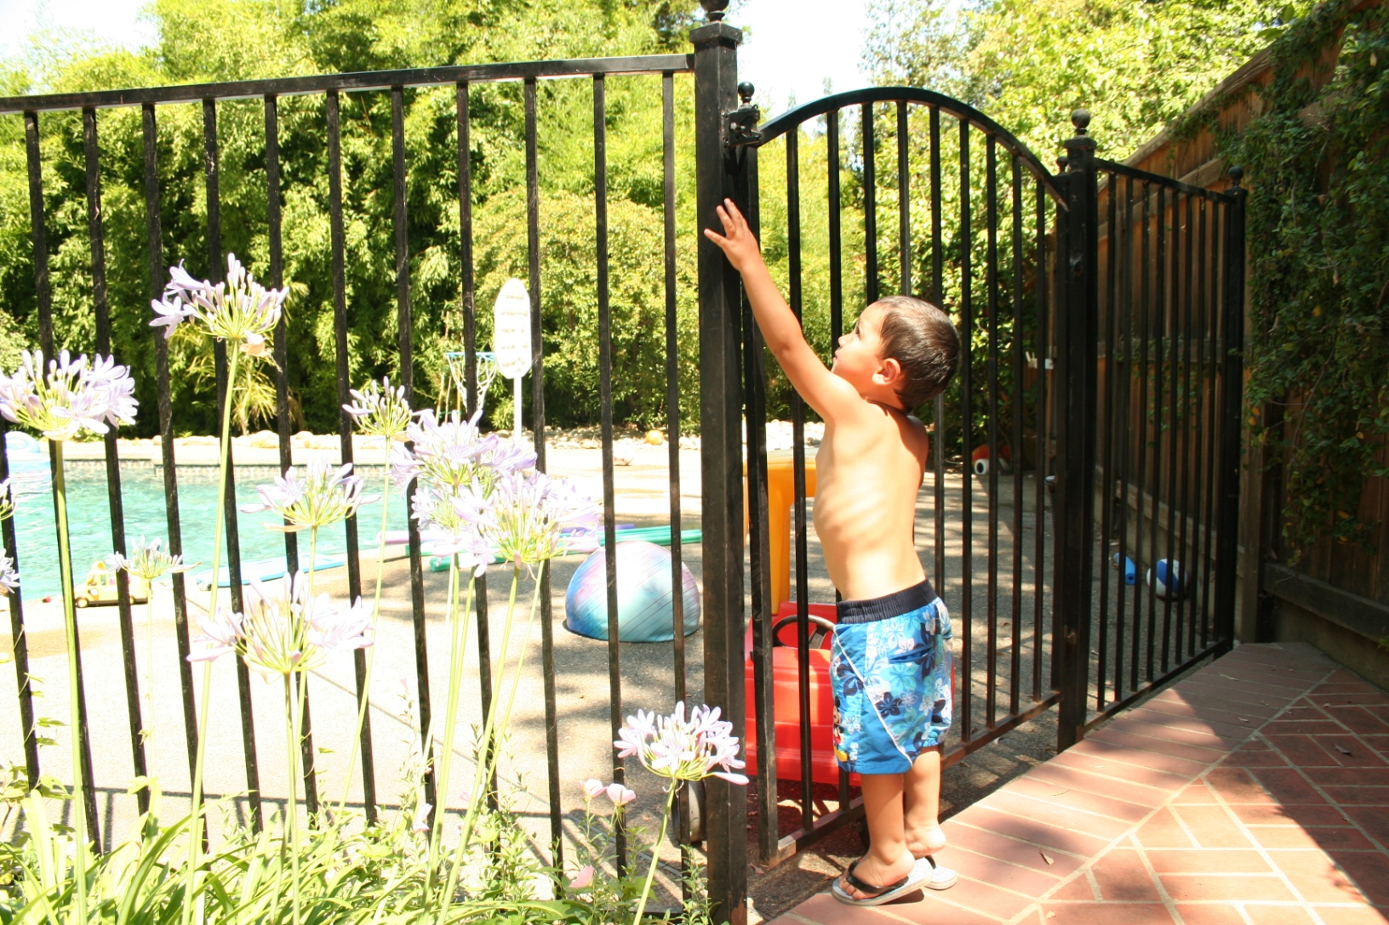
B is for Barriers
Notes:
This is one type of non-climbable 5 foot tall fence with self-closing self-latching gate.

Slide 18
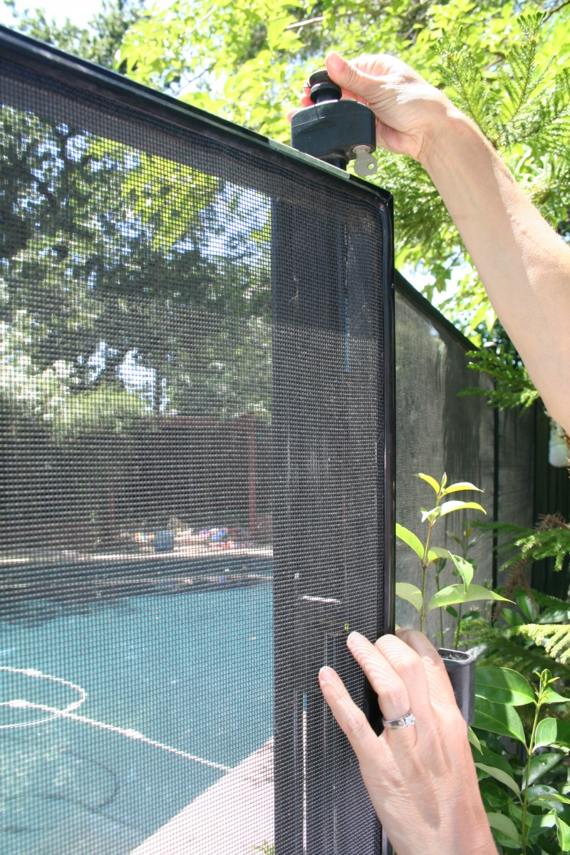
B is for Barriers

Slide 19
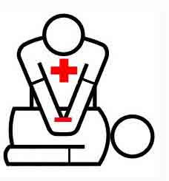
C is for CPR & Classes
Learn CPR (Cardiopulmonary Resuscitation) and rescue breathing.
Start CPR and rescue breathing at pool side.
To find CPR classes ask the Red Cross, American Heart Association, parks and recreation district or family resource center.
Notes:
Starting CPR at poolside also helps decrease potential brain damage. Every second counts.

Slide 20
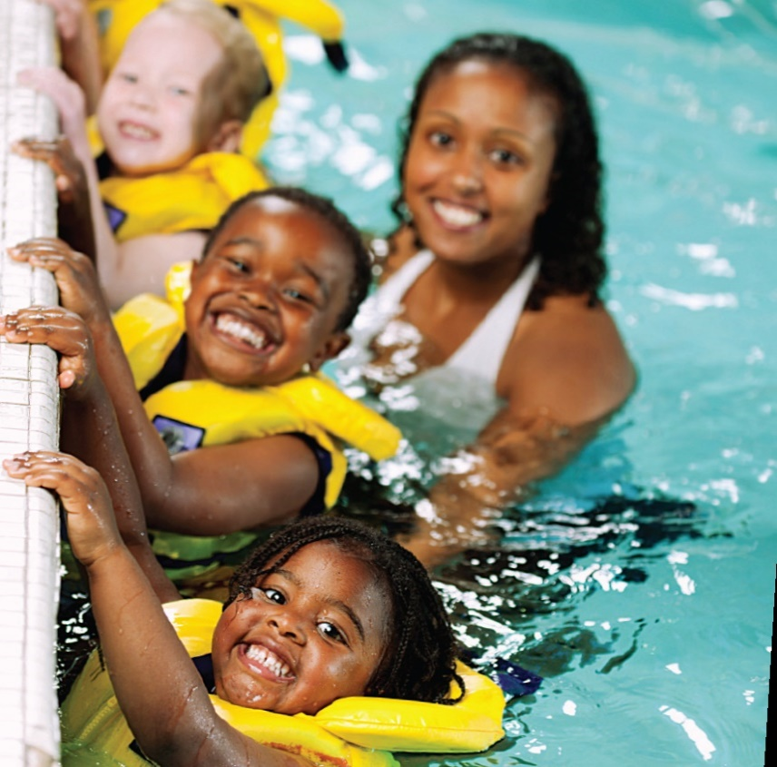
C is for CPR & Classes
Enroll all children and adults in your family in swim lessons and water safety training, but remember these classes never take the place of supervision or barriers!
To find swimming classes ask at a local community pool, parks and recreation district or family resource center.

Slide 21

ABC’s of Drowning Prevention Video
View on Metro Fire’s YouTube page
or go to YouTube and search “ABCs Drowning Prevention Sacramento”

Slide 22
Child Drowning myths and facts
Share it with a friend! If you heard a water safety myth from a friend or family member, how would you answer them with what you have learned today?
Role playing exercise

Slide 23
Child Drowning
Myths and Facts – Part 2
Myth: “It can’t happen to me. I’m a good parent.”
Fact: All parents whose children have drowned felt this way. No one believes a drowning could happen to their child or the children under their care. Without layers of protection, no child is safe from the tragedy of drowning.

Slide 24
Child Drowning
Myths and Facts – Part 2
Myth: “My child is safe because he’s had swimming lessons.”
Fact: When a child enters a pool alone, he may not behave the same way he does in a swimming lesson because no one is there to cue him to swim or behave in a certain manner.

Slide 25
Child Drowning
Myths and Facts – Part 2
Myth: “I’ll hear my child if he’s in trouble.”
Fact: Drowning is a silent event. Drowning children don’t splash, cry, or call out for help. “Kids drown without a sound”.

Slide 26
Child Drowning
Myths and Facts – Part 2
Myth: “My child is safe because he’s inside the house with me.”
Fact: Don’t assume your child is safe because you last saw him napping or playing. Toddlers move fast. Unless the child is within your direct sight, there is the possibility he is in the water.

Slide 27
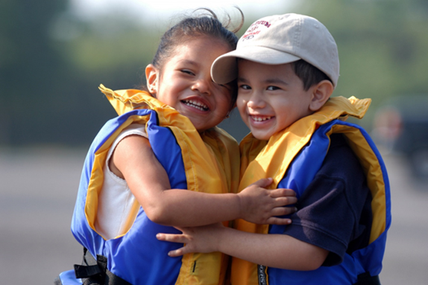
Life Jackets

Slide 28
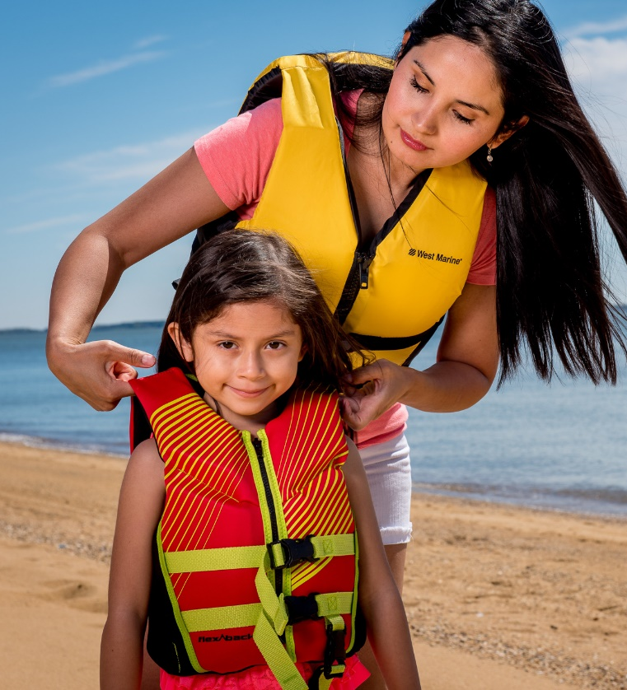
Wear a Life Jacket
Sacramento County – All children under 13 must wear life jackets when in waterways (rivers)
Use only US Coast Guard approved life jackets
Floaties and water wings are toys, not life-saving devices
Life jackets are not a substitute for Adult Supervision
Notes:
Why we wear life jackets
The Sacramento region is home to the American and Sacramento Rivers. These rivers originate from snow melt in the Sierra Nevada Mountains, and by the time they reach the Sacramento Valley, their waters are fast, cold, and full of debris.
Even the strongest swimmer can be pulled under.
Anyone on a raft, kayak, canoe, or inner tube should always wear a life jacket.
Floats, such as tubes, air mattresses or ‘floaties’ are toys and are not substitutes for a life jacket.
California and Sacramento laws
CA law states that all persons on board a personal watercraft (like a jet ski) and all persons being towed behind a vessel (as in water skiing) must wear a life jacket.
California law states that all children 13 and under must wear a properly fitting, U.S. Coast Guard-approved life jacket while underway on a vessel of 26 feet or less. https://dbw.parks.ca.gov/?page_id=28751
There is a Sacramento County ordinance requiring any child under the age of 13 to wear a life vest before accessing any public waters and violation of the ordinance punishes parents with a fine of $500 and/or six months in jail. It’s your responsibility to make sure your child is wearing a life vest. (Includes boating, swimming, and wading.) https://regionalparks.saccounty.gov/Rangers/Pages/RulesRegulationsLifeJacketOrdinance.aspx

Slide 29

Notes:
Play video
How to choose and fit a life jacket
Demonstrate how to properly fit a life jacket
Demonstrate what happens when a life jacket does not fit properly (too loose, slips off over head)
The Best life jacket is one that:
Fits properly
Is marked with a U.S. Coast Guard-approved number.
Is in good condition. At the beginning of each boating season:
Check that all hardware and straps are in good shape, firmly attached, and in working order.
Faded material can indicate loss of strength. Weathered lifejackets may tear more easily and can result in loss of flotation material.
Check for leaks, mildew, & oil saturation in the fabric.
Make sure there are no rips or tears in the fabric.
Make sure the label stating USCG approval is attached, and that it is readable.
Discard and replace life jackets that show signs of deterioration – faded material, tears, mildew stains, punctures, etc. When not in use, store lifejackets in a dry, cool, and dark place.
Has reflective tape and a whistle attached
Is the right type of life jacket for the type of swimming, boating, or water sports you will be doing.
Types of Life Jackets - https://dbw.parks.ca.gov/?page_id=29182
If a life jacket fits properly...
It will help keep your head above the water.
If it's too big, the life jacket will ride up around your face.
If it's too small, it will not be able to keep your body afloat.
Life jackets designed for adults will not work for children!
Try it on for size!
Check the manufacturer's label to ensure that the life jacket is a proper fit for your size and weight.
Make sure the jacket is properly fastened.
Hold your arms straight up over your head.
Ask a friend to grasp the tops of the arm openings and gently pull up.
Make sure there is no excess room above the openings and that the jacket does not ride up over your chin or face.
For the best fit, try the life jacket in shallow water under safe and supervised conditions.

Slide 30
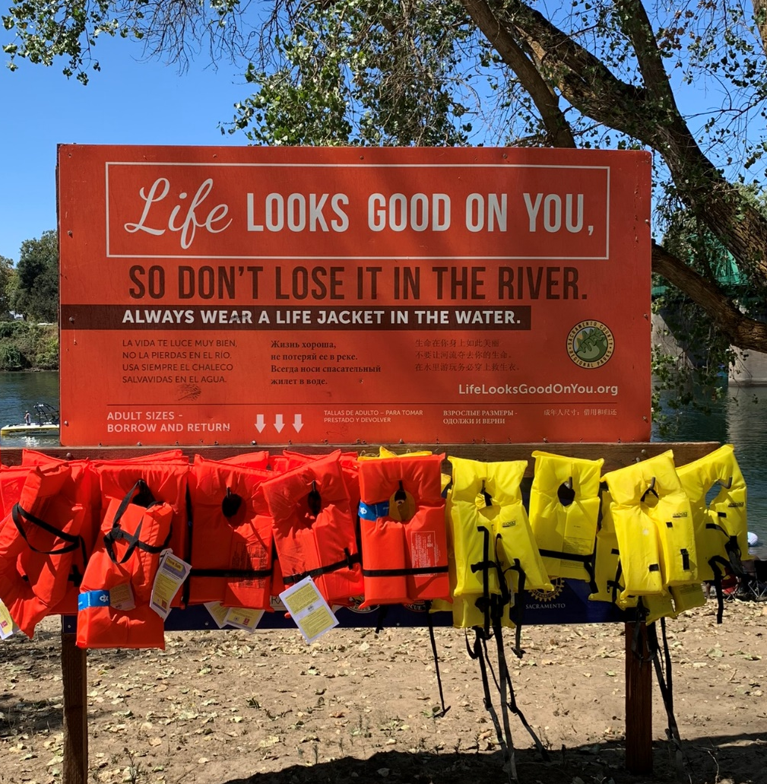
Life Jacket Loaner Boards - FREE
Borrowing stations along the public waterways in Sacramento County. Borrow one for you and your child and return it when you’re done.
American River Parkway (kids only)
Aquatic Center at Lake Natoma
Fire Station Loan Stations
Notes:
Borrow a life jacket
The "Kids Don't Float" life preserver loaner program provides jackets for temporary use that are hung on loaner boards along local waterways. There are also borrowing stations at some local fire stations.
River Loaner Boards - https://regionalparks.saccounty.gov/Rangers/Pages/KidsDontFloat.aspx
Fire Department loan stations - https://dbw.parks.ca.gov/?page_id=29179#sac

Slide 31
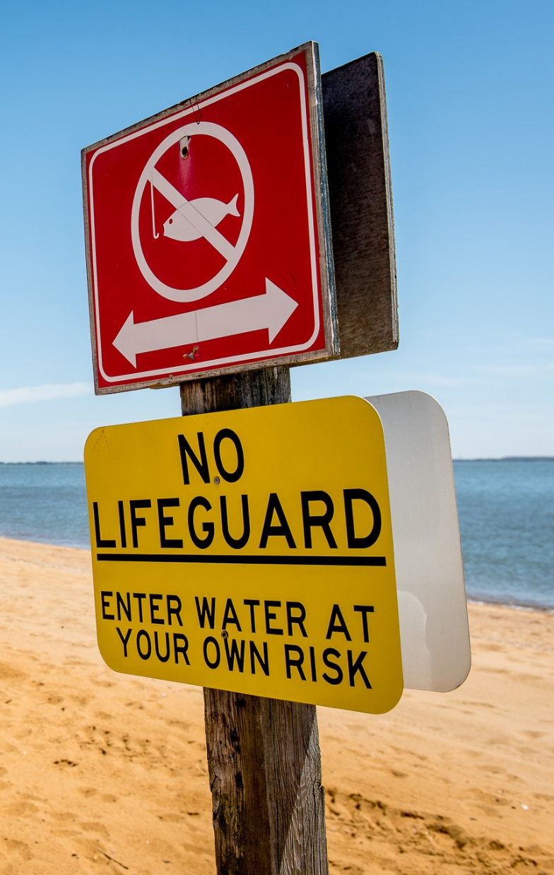
Look Before You Leap
Obey the signs – “No Swimming or No Diving”
Riverbeds can drop off sharply. Stay close to shore.
The surface may look smooth, but our rivers are fast and strong!
Ask yourself?
  Is the water deep enough?
  How cold is the water?
  Are there hazards under the water that I can’t see from the surface?
Notes:
Lesson 4: Look Before you Leap!
Before jumping in, enter the water slowly, feet first. If you are not familiar with the water, and cannot determine the depth or observe potential hazards, do not enter the water.
The water surface may look smooth, but the current and undertow can be strong.
Stay close to shore to avoid drop-offs and currents. While there may be a gradual slope as you enter the water near shore, there might be a sudden drop-off further out.
Never use rope swings or jump off bridges - No matter how deep the water is, these activities can result in serious injury or death
Don’t jump or dive into shallow water.
Hitting your head can have big consequences.
Don’t swim in an aqueduct or a canal. Swimming in a canal is against the law. If you enter a canal, you are trespassing and can be arrested or fined.

Slide 32
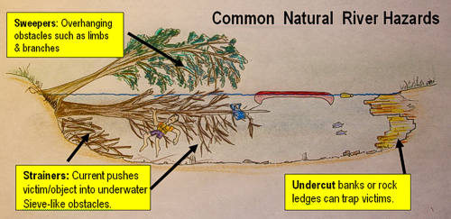
River Safety

Slide 33

Thank You!
Thank you for making the best water safety choices for your baby and child.

